Slide 1


Estimation of COVID-19 risk-stratified epidemiological parameters and policy implications for Los Angeles County through an integrated risk and stochastic epidemiological model
Dave Conti
Professor, Division of Biostatistics
Abigail Horn
Postdoctoral Fellow
Department of Preventive Medicine
USC
uscbiostats.github.io/COVID19

Slide 2
Overview
We developed an epidemic model to estimate the impact of COVID-19 in Los Angeles County.
We address the key questions of:
When and how did the epidemic dynamics impact health care capacity?
How did the epidemic affect different at-risk groups?
What would have happened to the dynamics of the epidemic under various policy implementations for social distancing and protection of at-risk groups?

Slide 3
Why Our Model is Unique
Integrates a dynamic epidemic model with a relative risk model to produce time-varying subpopulation-stratified estimates of severe illness probabilities, CFR, and IFR
Subpopulation-stratified probabilities across 39 “risk profiles” – combinations of risk factors (advanced age, existing health conditions, unhealthy behaviors)
Epidemic model: Uses a stochastic process model with approximate Bayes calculations for estimation.
Risk model: Logistic regression framework mean-centered on estimates from epidemic model.
Presents the uncertainty in all estimations and predictions.
Incorporates external information to inform prior distributions for parameter specification.
Evaluates alternative policy options for social distancing and protection of at-risk groups.

Slide 4
3 Parts: Epidemic Model Risk Model Scenario Analysis
Notes:
of our model over existing models estimating hospital resource demand is that it accounts for combinations of risk factors (age, unhealthy behaviors, existing comorbidities, and combinations of comorbidities), including area-level differences in prevalence of these risk factors, in determining COVID intensity. Accounting for differential risk for specific populations is important both for making projections about the scale of the epidemic, and for prioritizing at-risk populations for protection.

Slide 5
Epidemic Model: Methods
Notes:
of our model over existing models estimating hospital resource demand is that it accounts for combinations of risk factors (age, unhealthy behaviors, existing comorbidities, and combinations of comorbidities), including area-level differences in prevalence of these risk factors, in determining COVID intensity. Accounting for differential risk for specific populations is important both for making projections about the scale of the epidemic, and for prioritizing at-risk populations for protection.

Slide 6
A
Transition times
Fixed parameters
d_{IR}
1-r(t)
d_{EI}
S
E
I
R
μ(t)β
r(t)
1-α(t)
d_{EI}
d_{IR}
1-κ(t)
α(t)
d_{IH}
Each arrow has a transition rate
Some arrows have transition probabilities
H
d_{HR}
1-δ(t)
d_{HQ}
S = Susceptible
E = Exposed
A = Infected/Undetected
I = Infected/Detected
H = Hospitalized
Q = ICU
V = Ventilated
D = Death
R = Recovered
κ(t)
Q
d_{QD}
V
d_{QV}
D
δ(t)

Slide 7
A
d_{IR}
1-r
d_{EI}
S
E
I
R
μ(t)β
r
1-α
d_{EI}
d_{IR}
α
d_{IH}
1-κ
H
d_{HR}
1-δ
d_{HQ}
κ
Q
d_{QD}
V
d_{QV}
D
δ

Slide 8
Time-dependent Factor reduction in R0
Proportion of infections that are detected
A
Estimated parameters
1-r(t)
S
E
I
R
μ(t)β
r(t)
1-α(t)
1-κ(t)
β = Transmission rate
The average number of individuals that an infected individual will infect per day
β ~ R0
α(t)
Pr(Hospital|Illness)
H
1-δ(t)
S = Susceptible
E = Exposed
A = Infected/Undetected
I = Infected/Detected
H = Hospitalized
Q = ICU
V = Ventilated
D = Death
R = Recovered
κ(t)
Q
Pr(ICU|Hospital)
V
D
δ(t)
Pr(Death|ICU)

Slide 9
Time-dependent Factor reduction in R0
Proportion of infections that are detected
A
1-r
S
E
I
R
μ(t)β
r
1-α
Transmission rate
β ~ R0
α
1-κ
Pr(Hospital|Illness)
H
1-δ
κ
Q
Pr(ICU|Hospital)
V
D
δ
Pr(Death|ICU)

Slide 10
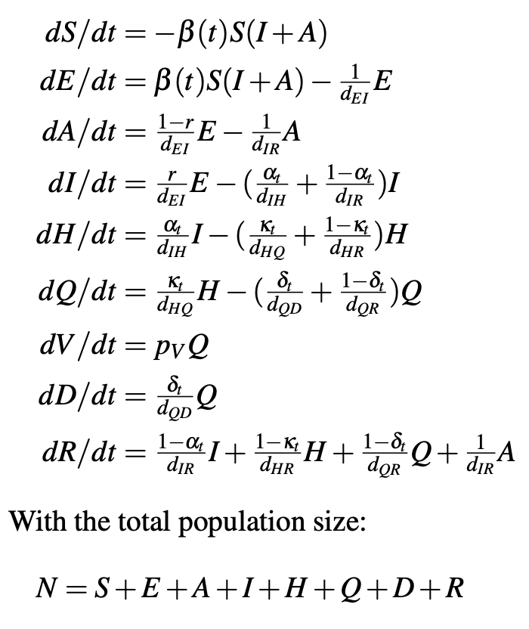
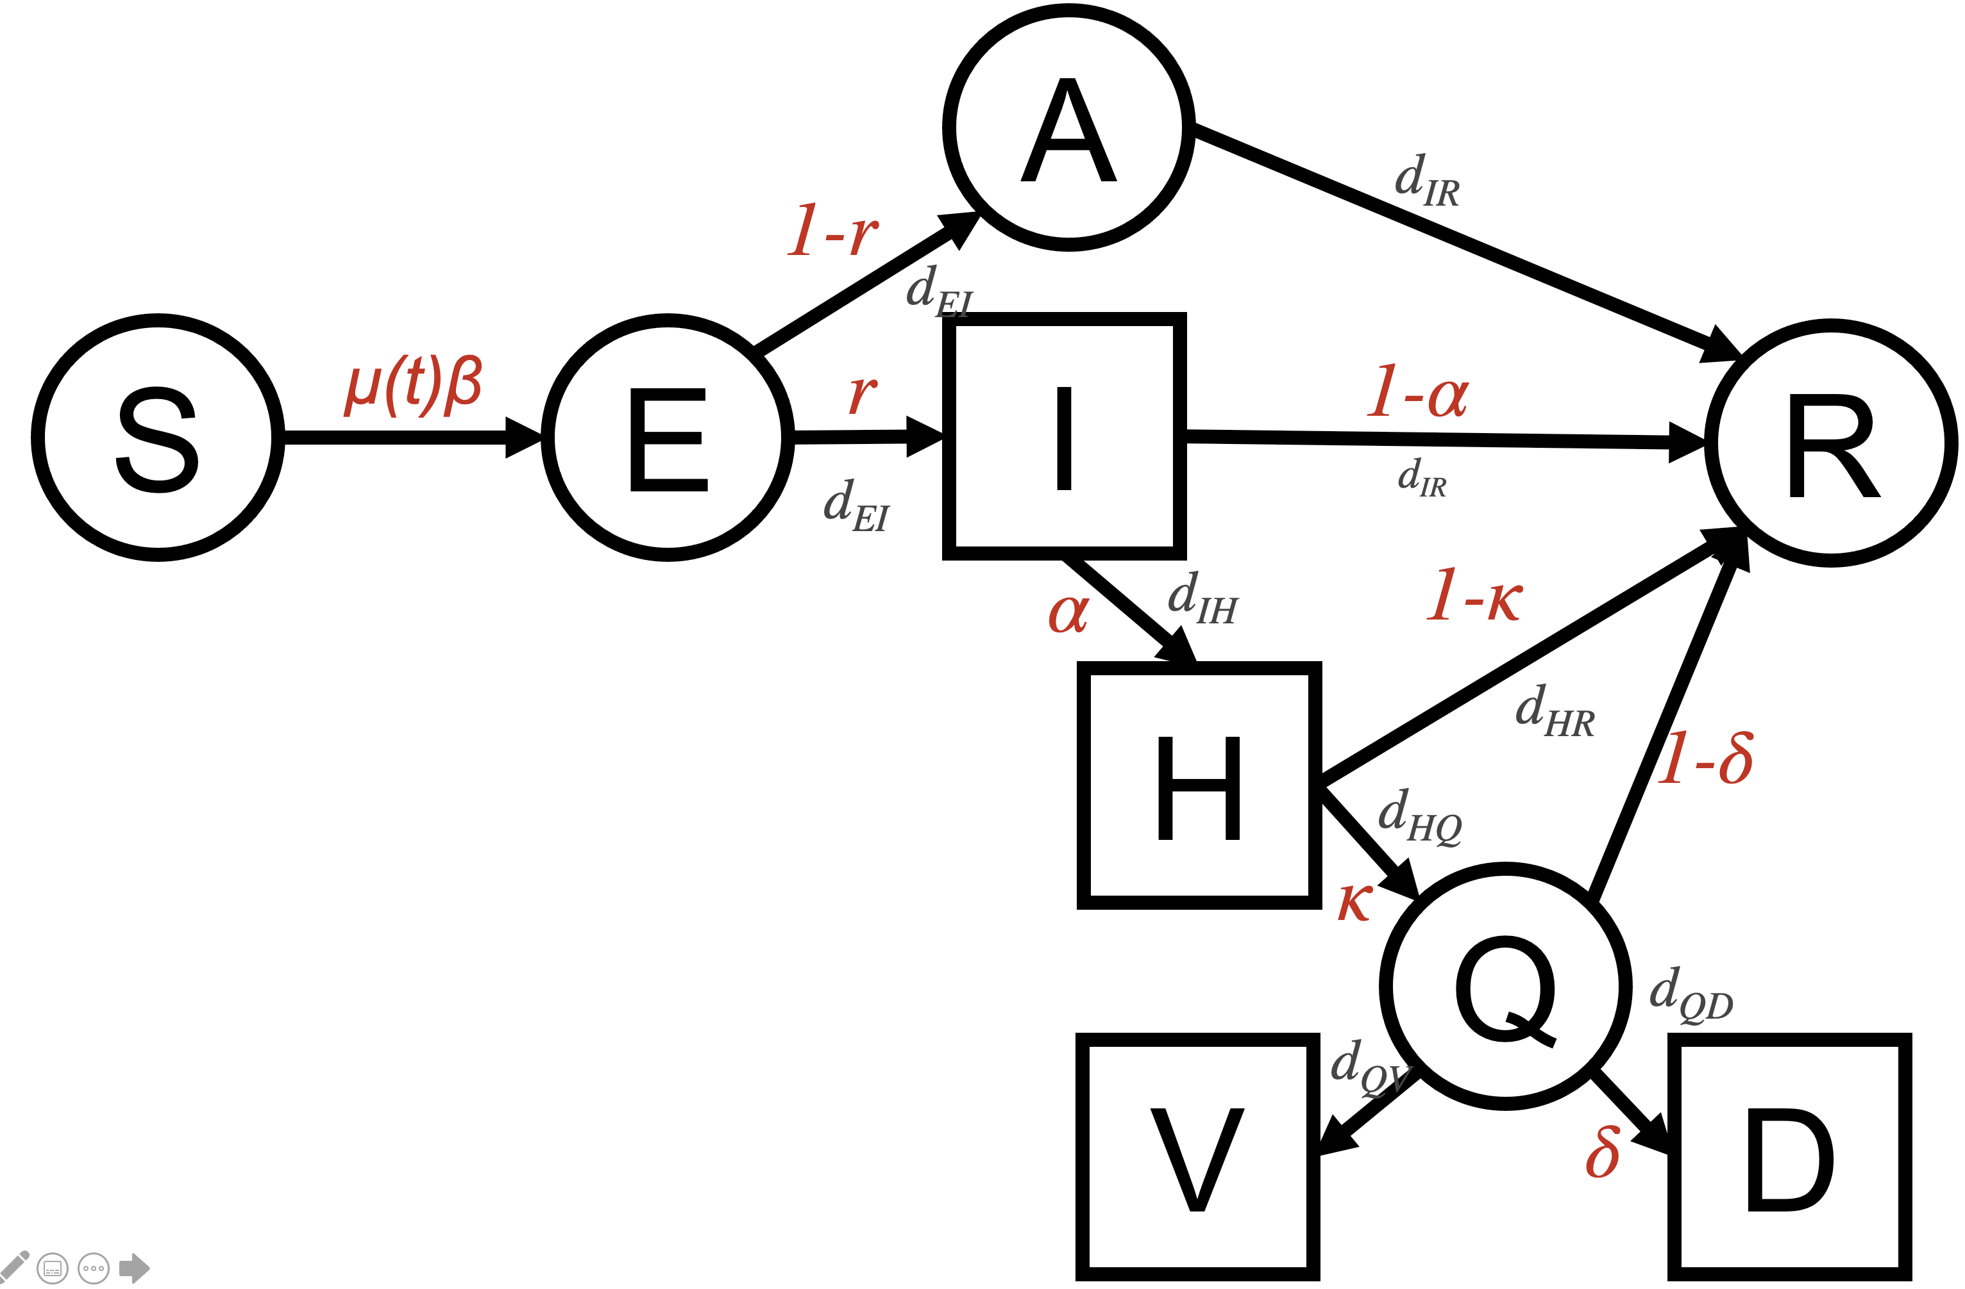
Deterministic ODE model and
branching probabilities

Slide 11
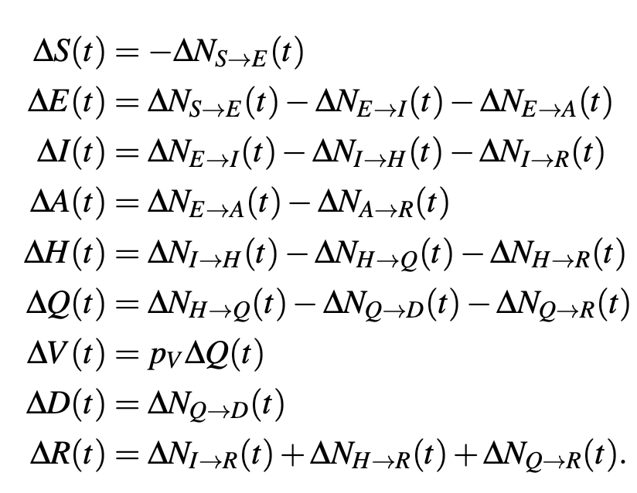
Stochastic model
We develop a stochastic discrete-time model of the dynamical state system.
We model the number of individuals leaving any of the classes by all available routes over a particular time interval by a set of coupled multinomial counting processes with random transition rates.
In the limit as the time interval ∆t → 0, this discrete stochastic process fulfills the properties defining a continuous time Markov process.
The counting process random variables are coupled to the state variables via the following identities:
Time step: ∆t = 1 day
Notes:
Transitions of individuals from one to the next stage of the disease are seen as stochastic movements between the corresponding population compartments at transition rates with random fluctuations.

Slide 12
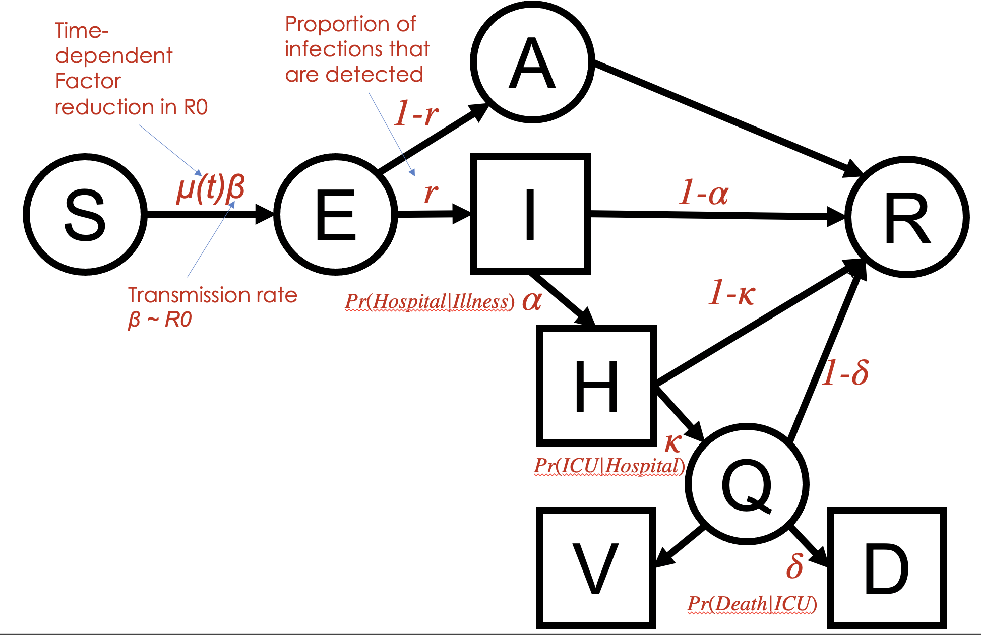
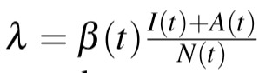
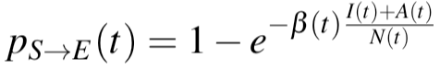
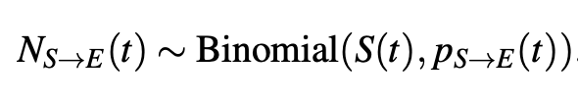
Counting processes for transitions between states
Example: New latent infections (S to E transitions)
New infections I occur from interactions between S and I or A, but arise first in E
The rate at which susceptible individuals become infected is described by the force of infection, λ
λ = infections per day per infected individual * fraction of individuals that are infected, i.e.
We assume that the corresponding probability at time t that a susceptible individual becomes infected and leaves (S) is
The overall number of individuals becoming infected and moving from the S to the E compartment in one time step, NS→E , is distributed as a binomial distribution with one draw for each of S individuals, each with probability p_{S→E}(t), i.e.
Notes:
We develop a stochastic discrete-valued approximation of the ODE dynamics based on an Eulerian numerical solution approach [5, 6]. In this model, individuals move between compartments according to counting processes with transitions mathematically defined by binomial and multinomial distributions with exponential transition probabilities. Binomial distributions are used to determine the numbers of individuals leaving a given compartment when there is only one direction to go in, and multinomial distributions are used when individuals leaving a compartment are distributed across multiple compartments. Sampling from binomial and multinomial distributions allows ensuring that no more individuals leave a compartment than there are in that compartment. A draw happens for each individual, and with a certain probability, the distribution determines how many will end up in each compartment. The model is fully stochastic in that for a fixed set of parameter values and initial conditions, it will generate an ensemble of epidemic realizations leading to different values in state variables by time. The stochastic model provides a few advantages in our modeling and parameter estimation framework over the deterministic model, which provides the mean-field result. These include that it provides an effective framework for parameter estimation and for generating confidence bounds reflecting stochasticity of the disease process in model projections.

Slide 13
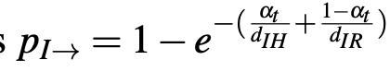
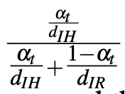
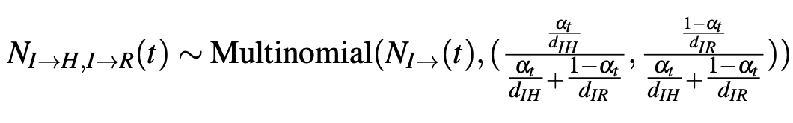
Counting processes for transitions between states
Example: Transitions out of observed infectious state (I)
Individuals in I may go to H or to R
First we find the probability of departures from I. The probability that an infected individual transitions out of I in each time step is equal to
1 – exp(- total rate of departures out of I), i.e.
Second we find relative departure probabilities. For example, the conditional probability a departure is to H is
The number of infected individuals that become hospitalized in each time step, N_{I→H}, and that recover, N_{I→R}, can then be found with a multinomial distribution:
Notes:
We develop a stochastic discrete-valued approximation of the ODE dynamics based on an Eulerian numerical solution approach [5, 6]. In this model, individuals move between compartments according to counting processes with transitions mathematically defined by binomial and multinomial distributions with exponential transition probabilities. Binomial distributions are used to determine the numbers of individuals leaving a given compartment when there is only one direction to go in, and multinomial distributions are used when individuals leaving a compartment are distributed across multiple compartments. Sampling from binomial and multinomial distributions allows ensuring that no more individuals leave a compartment than there are in that compartment. A draw happens for each individual, and with a certain probability, the distribution determines how many will end up in each compartment. The model is fully stochastic in that for a fixed set of parameter values and initial conditions, it will generate an ensemble of epidemic realizations leading to different values in state variables by time. The stochastic model provides a few advantages in our modeling and parameter estimation framework over the deterministic model, which provides the mean-field result. These include that it provides an effective framework for parameter estimation and for generating confidence bounds reflecting stochasticity of the disease process in model projections.

Slide 14
Stochastic model
Why binomial and multinomial distributions?
Binomial distribution: one direction to go in
Multinomial distributions: multiple directions to go
Dealing with rates. Why not use Poisson processes?
Because we don’t always have n >> k and very small p
Bi/multinomial distributions ensure no more individuals leave a compartment then are in it
Why exponential transition probabilities?
Where would p come from for the binomial / multinomial distribution?
p =1 – exp(- total transition rate out) defines a probability strictly < 1
Notes:
We develop a stochastic discrete-valued approximation of the ODE dynamics based on an Eulerian numerical solution approach [5, 6]. In this model, individuals move between compartments according to counting processes with transitions mathematically defined by binomial and multinomial distributions with exponential transition probabilities. Binomial distributions are used to determine the numbers of individuals leaving a given compartment when there is only one direction to go in, and multinomial distributions are used when individuals leaving a compartment are distributed across multiple compartments. Sampling from binomial and multinomial distributions allows ensuring that no more individuals leave a compartment than there are in that compartment. A draw happens for each individual, and with a certain probability, the distribution determines how many will end up in each compartment. The model is fully stochastic in that for a fixed set of parameter values and initial conditions, it will generate an ensemble of epidemic realizations leading to different values in state variables by time. The stochastic model provides a few advantages in our modeling and parameter estimation framework over the deterministic model, which provides the mean-field result. These include that it provides an effective framework for parameter estimation and for generating confidence bounds reflecting stochasticity of the disease process in model projections.

Slide 15
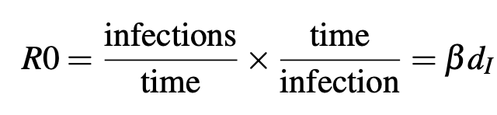
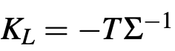
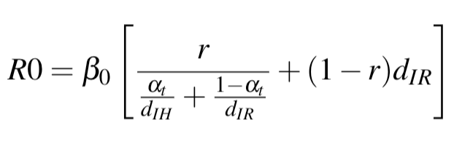
Calculating R0
R0 = The average number of new infections generated by an infected individual in a completely susceptible population
R0 is dimensionless.
For a simple SIR model, R0 is a simple expression equal to the product of the number of infections per time for an infected individual and the average duration of the infectious period:
Because our model involves multiple infectious classes with different rates of infection duration, we derive an expression through spectral analysis of the “next-generation matrix”, a matrix that relates the numbers of newly infected individuals in consecutive generations.
Specifically, R0 is the dominant eigenvalue of
We find:
New infections
New transmissions

Slide 16
Epidemic Model: Parameter estimation
Notes:
of our model over existing models estimating hospital resource demand is that it accounts for combinations of risk factors (age, unhealthy behaviors, existing comorbidities, and combinations of comorbidities), including area-level differences in prevalence of these risk factors, in determining COVID intensity. Accounting for differential risk for specific populations is important both for making projections about the scale of the epidemic, and for prioritizing at-risk populations for protection.

Slide 17
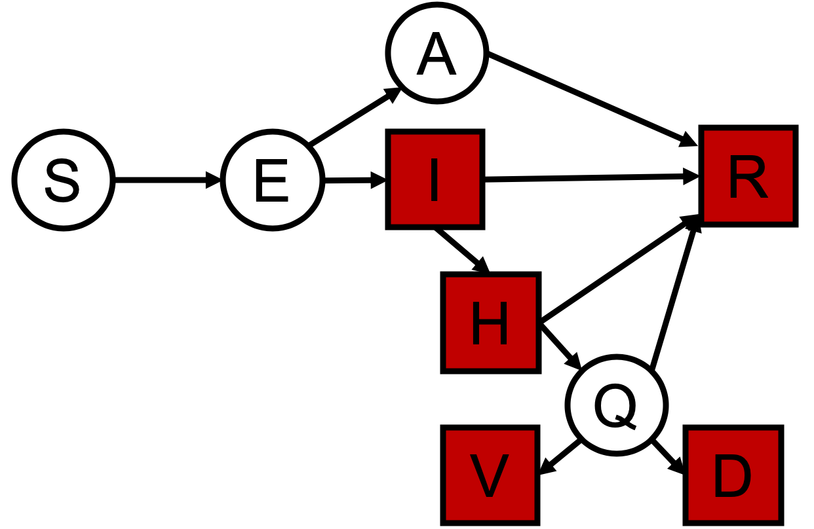
Data used for parameter estimation
The model predicts the counts of individuals in all categories over time.
Colored squares indicate categories in which observed COVID-19 data was available and used to fit the epidemic model:
Cumulative/New Illnesses
Cumulative/New Hospitalizations
Cumulative/New Ventilation Requirements
Cumulative/New Deaths
Cumulative Recovered
S = Susceptible
E = Exposed
A = Infected/Undetected
I = Infected/Detected
H = Hospitalized
Q = ICU
V = Ventilated
D = Death
R = Recovered
Data from:
March 1 - October 31, 2020

Slide 18
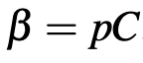
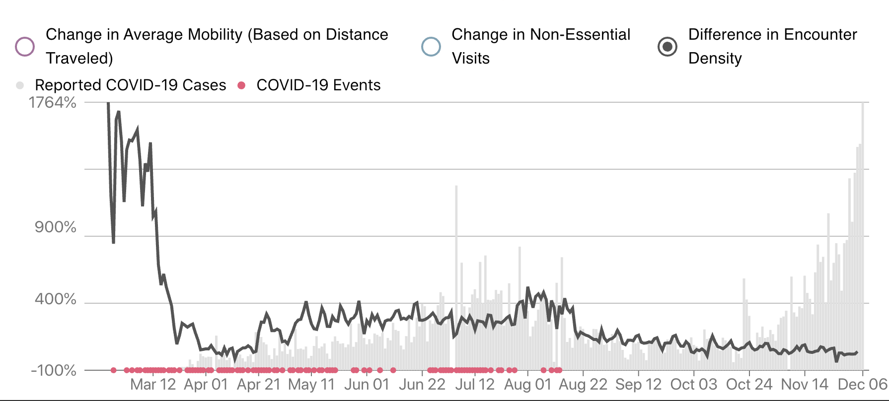
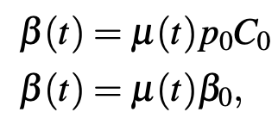
External sources of data to specify
prior parameter distributions
Prior for μ(t): Time-varying factor reduction in R0
→ Mobility data
Effectively, reductions in mobility correspond to a proportional reduction in R₀ because
R₀ ~ β
β ~ prob. of infection per contact *
rate of contacts over time
Therefore,
Mobility data for LA County
from Unacast

Slide 19
Approximate Bayesian Computation
We use Approximate Bayesian Computation (ABC) for parameter estimation.
A Bayesian framework assumes model parameters are Random Variables; we seek to estimate the posterior distribution of these parameters.
Benefits of using ABC include:
Estimating model parameters when a likelihood function is intractable or unknown, with multi-featured data samples
Including prior information + uncertainty for each parameter
Prioritizing data input that is more reliable in fitting the model to data (e.g., not including more unreliable early illness count data)
Notes:
In the Bayesian framework model parameters are assumed to be random variables and therefore have probability distributions, we seek to estimate the pos- terior distribution of these parameters (Gelman et al., 2013).
Approximate Bayesian Computation (ABC) methods can be used to approximate these posterior distributions when a likelihood function is intractable or not known (Beaumont et al., 2002), and can be used when the data available are coarse or complex.

Slide 20
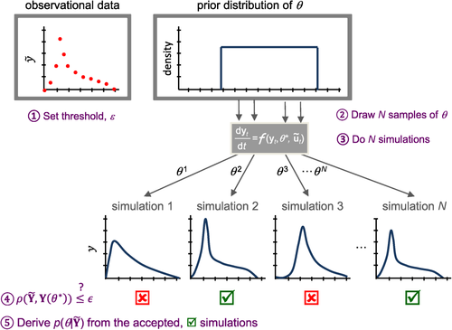

Approximate Bayesian Computation
Generalize to:
Multiple parameters
Multiple observed variables
Set threshold ε for distance between data and simulation
d(D, D*)
Draw N samples of θ
Do N simulations
Input into Epidemic Model
Accept if d(D, D*) < ε
Approximate P(θ|D) ≈ P(θ|d(D, D*) ≤ ε)
Marjoram et al. (2003), PNAS
Figure adapted from Sadegh and Vrugt (2014)

Slide 21
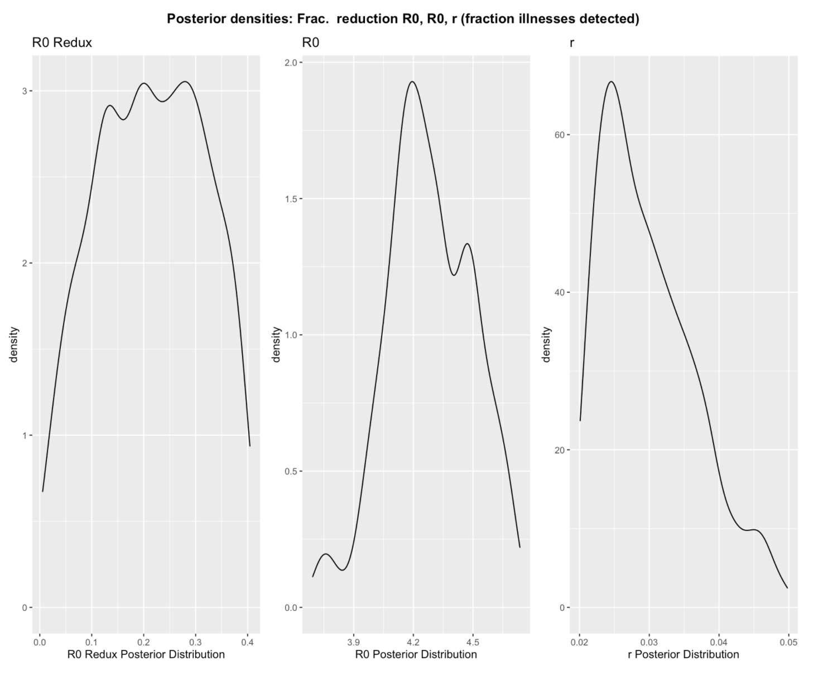
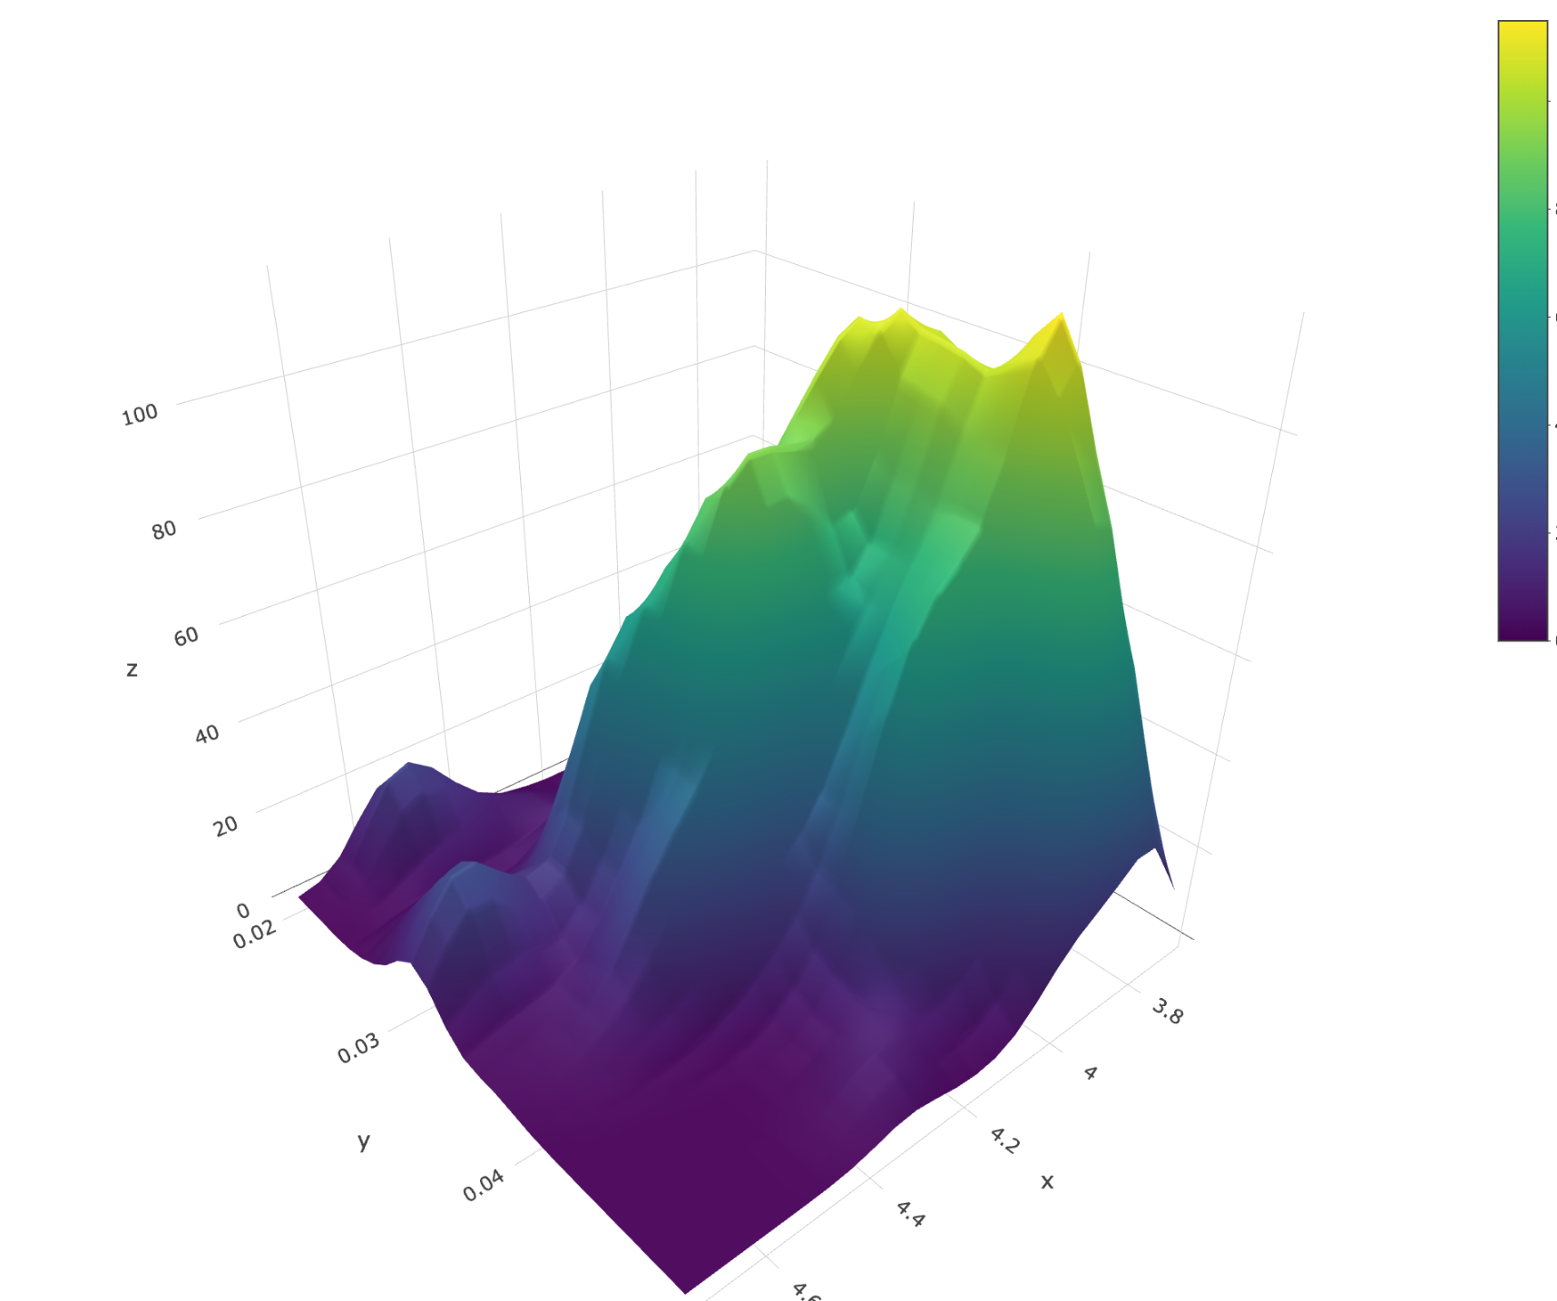
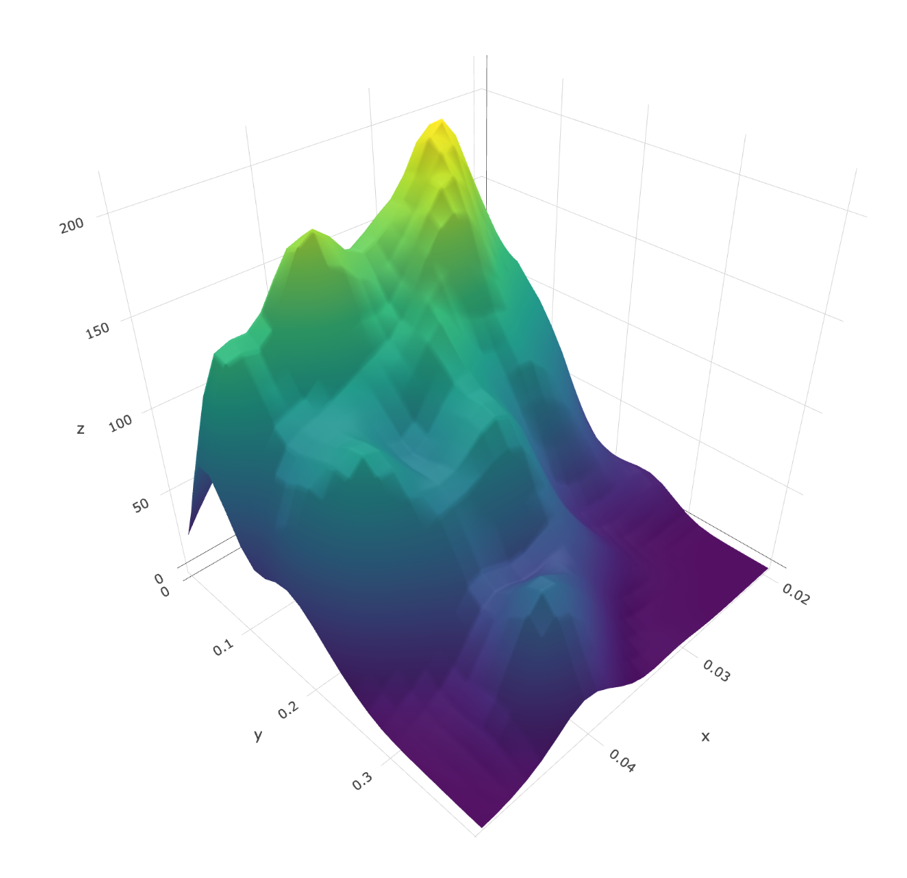
How we estimate uncertainty
Using ABC to estimate multiple parameters simultaneously produces joint posterior estimates over all estimated parameters.
In forward simulations of our model (model predictions), we simulate trajectories with parameter values sampled from this joint posterior distribution.
Uncertainty is also contributed by the stochastic process model, which adds stochasticity in numbers of transitions between compartments.
Example marginal posterior densities
Example joint posterior densities

Slide 22
Epidemic Model: Estimates
Notes:
of our model over existing models estimating hospital resource demand is that it accounts for combinations of risk factors (age, unhealthy behaviors, existing comorbidities, and combinations of comorbidities), including area-level differences in prevalence of these risk factors, in determining COVID intensity. Accounting for differential risk for specific populations is important both for making projections about the scale of the epidemic, and for prioritizing at-risk populations for protection.

Slide 23
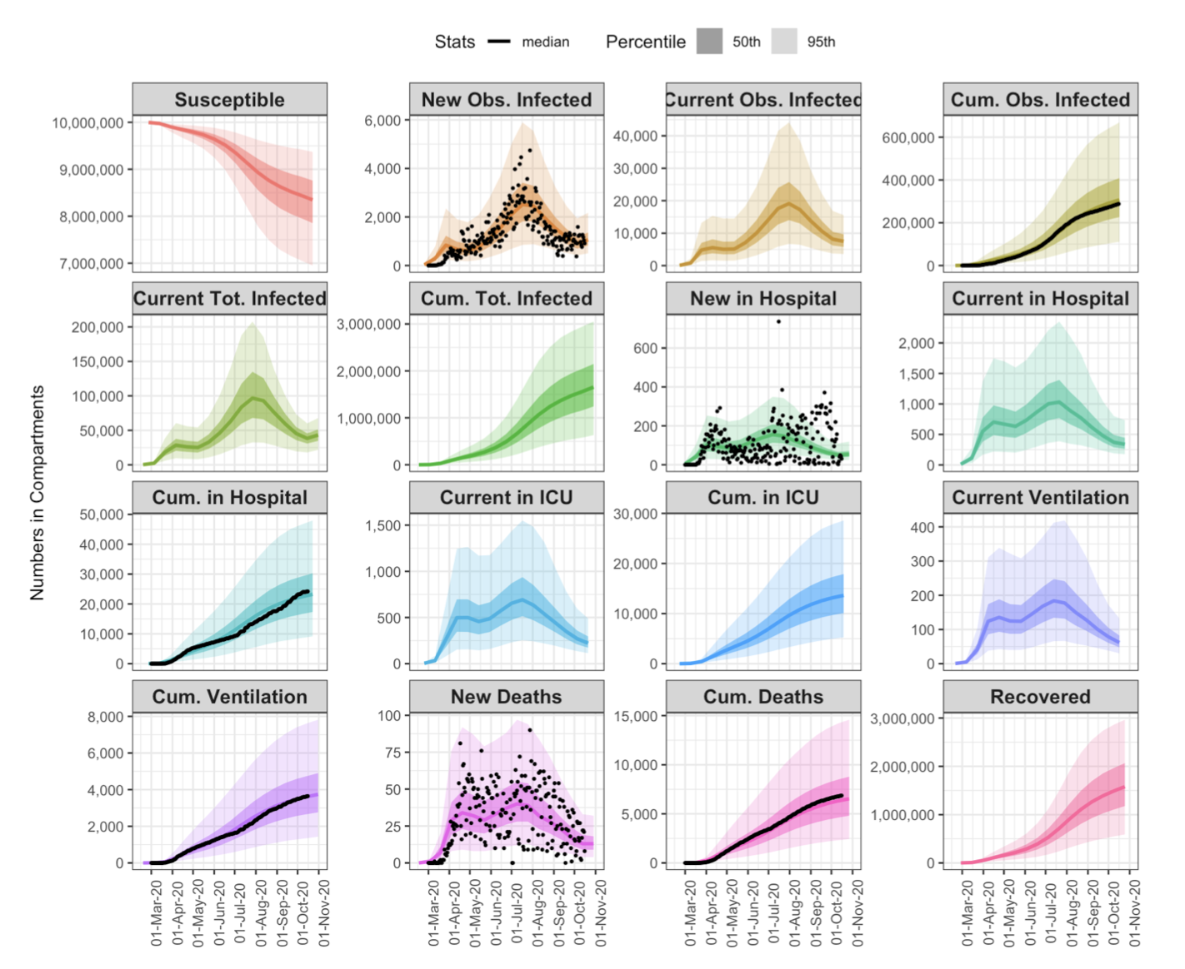
Assessing Model Fit with Data
Solid/Dash lines: Mean/Median Prediction; Dark/light bands: 50% and 95% of all simulations
Black dots: COVID-19 data from Los Angeles County Department of Public Health

Slide 24
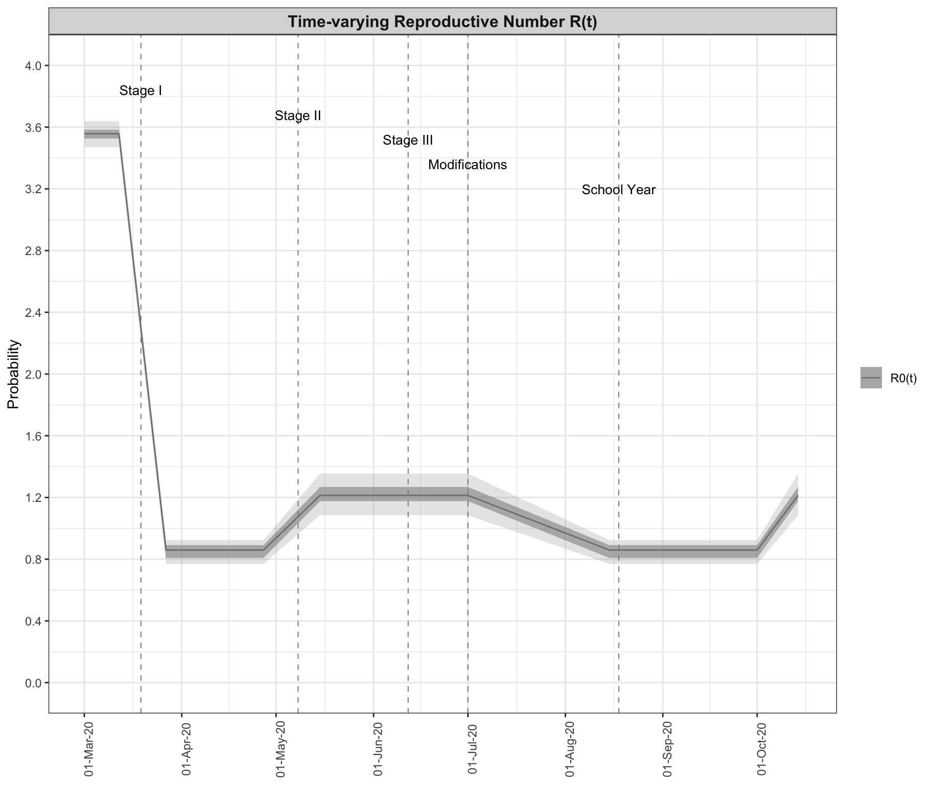
Trends in R(t)

Slide 25
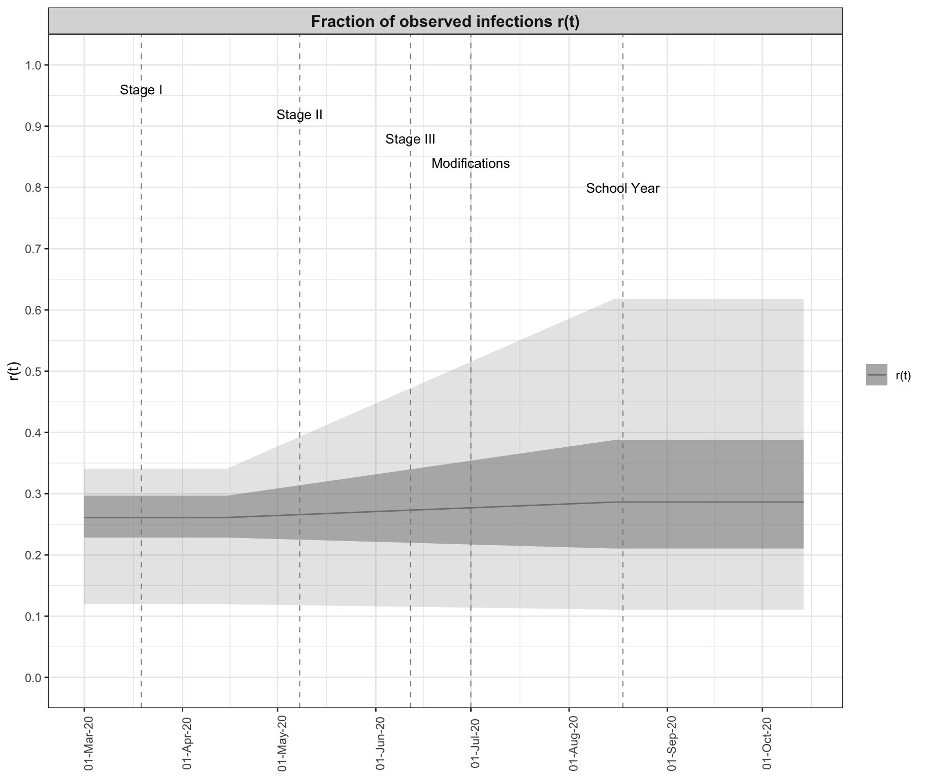
Trends in r(t): fraction of observed infections

Slide 26
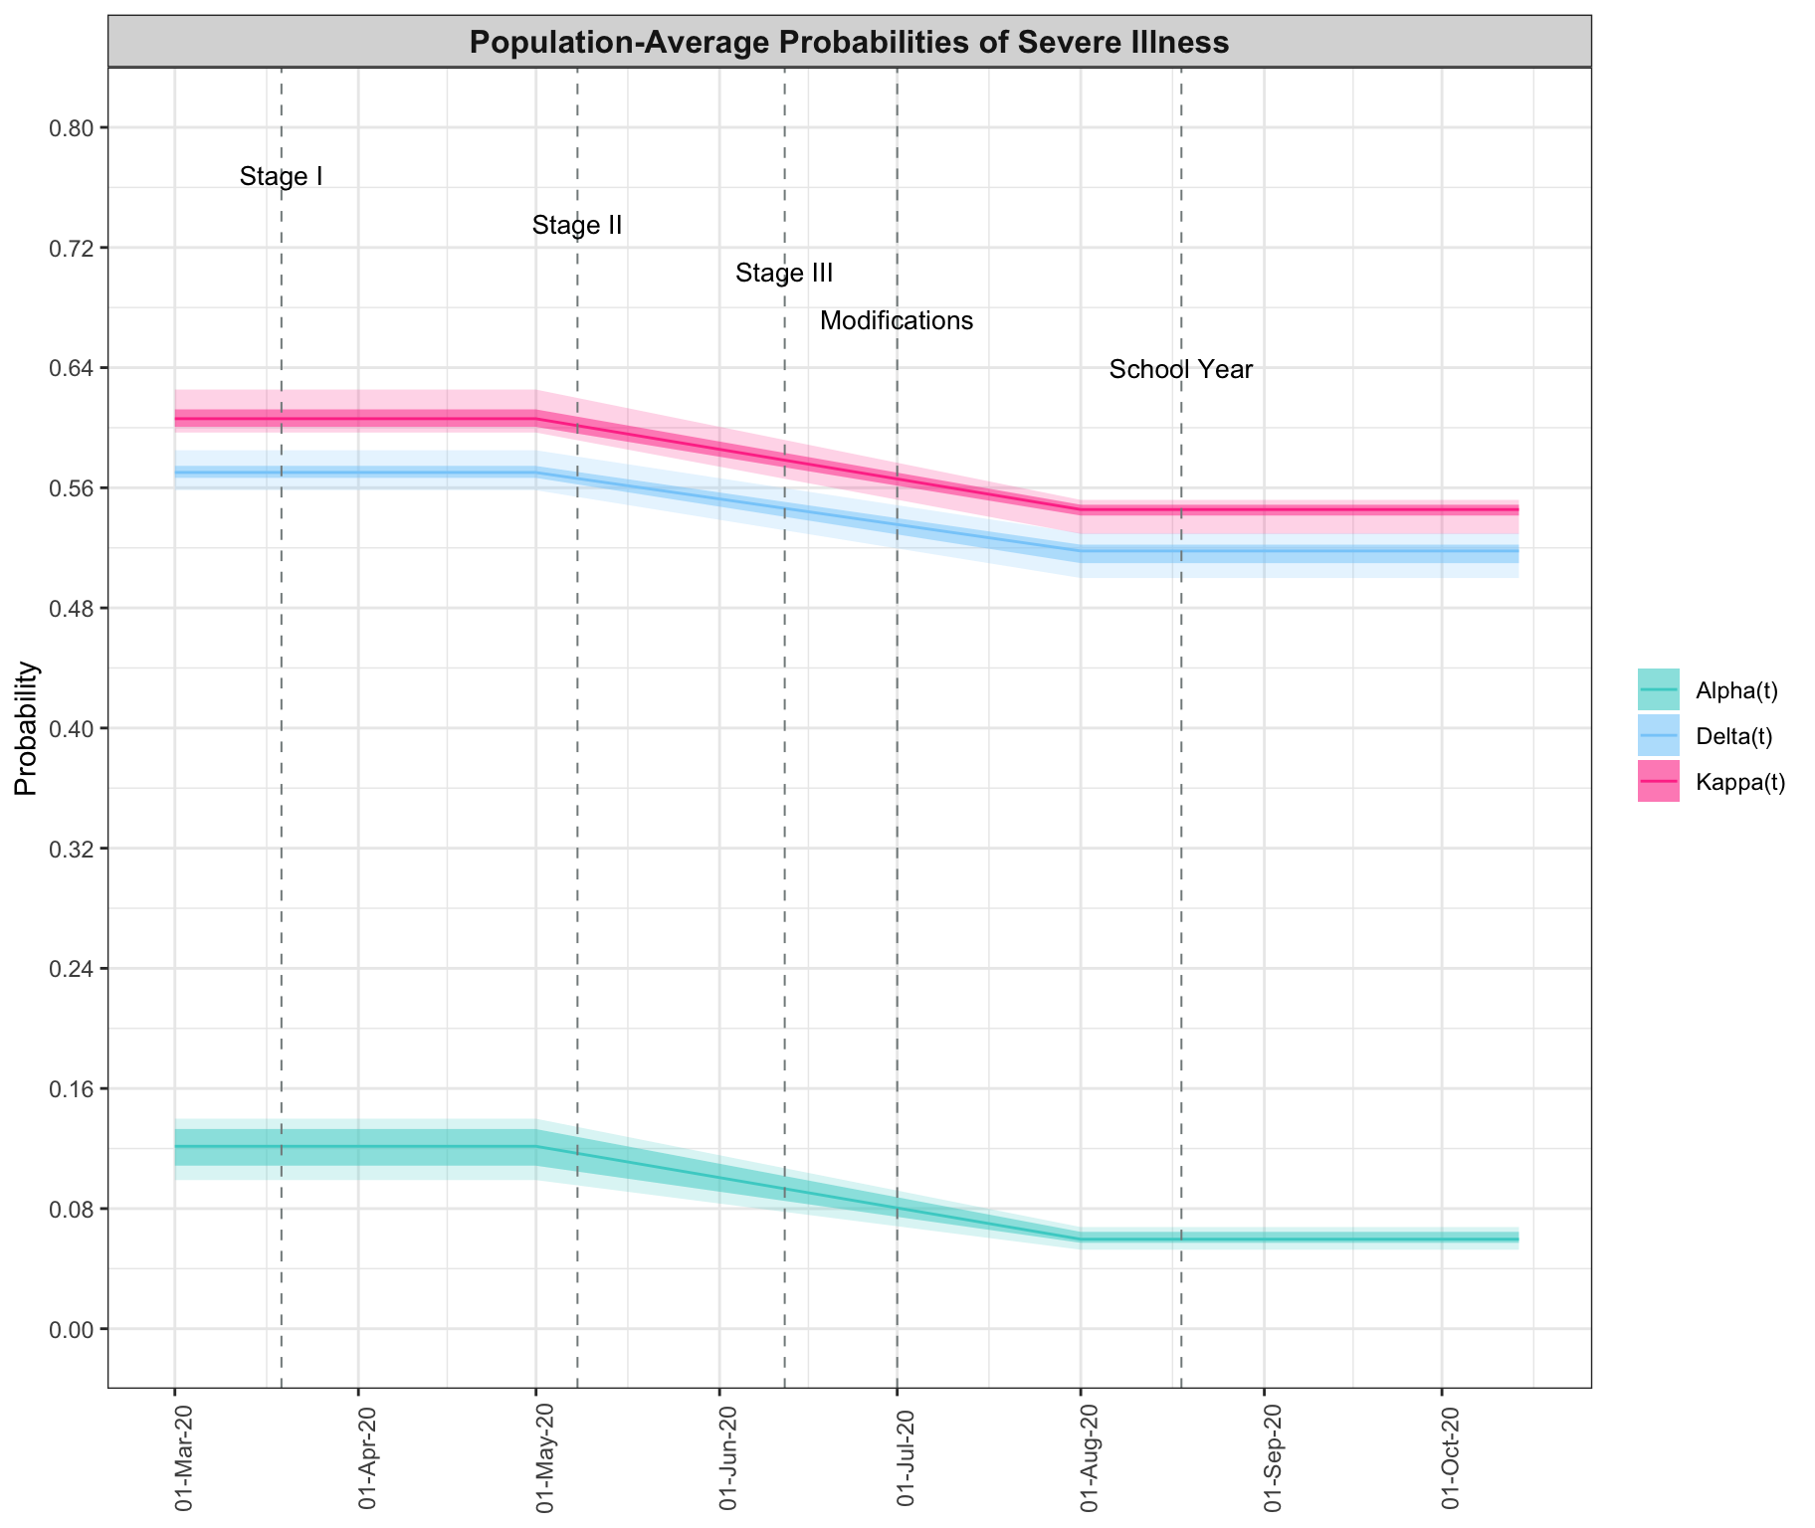
Population Average Probabilities of Severe Disease
2 Phases of the epidemic
Changing age distribution in infections:
April 20: 23% 65+, 1% <18
July 20: 12% 65+, 10% <18

Slide 27
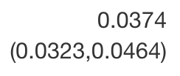
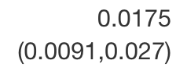
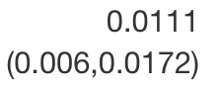
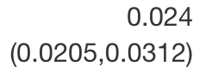
Time-varying CFR and IFR
May 15
Oct 15
May 15
Oct 15

Slide 28
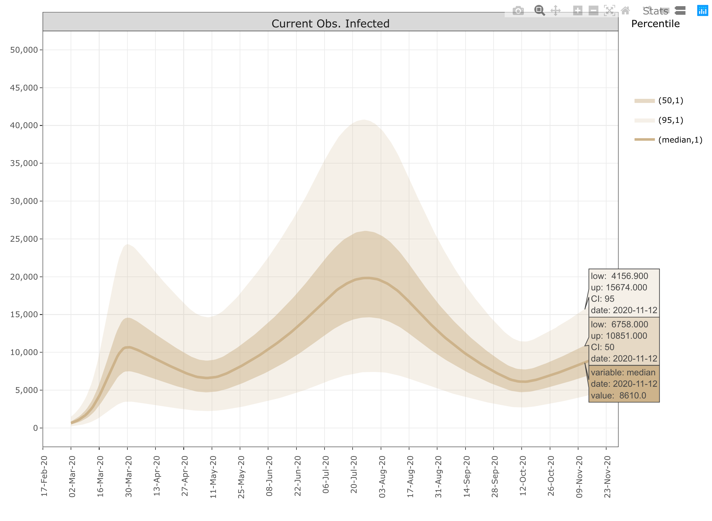
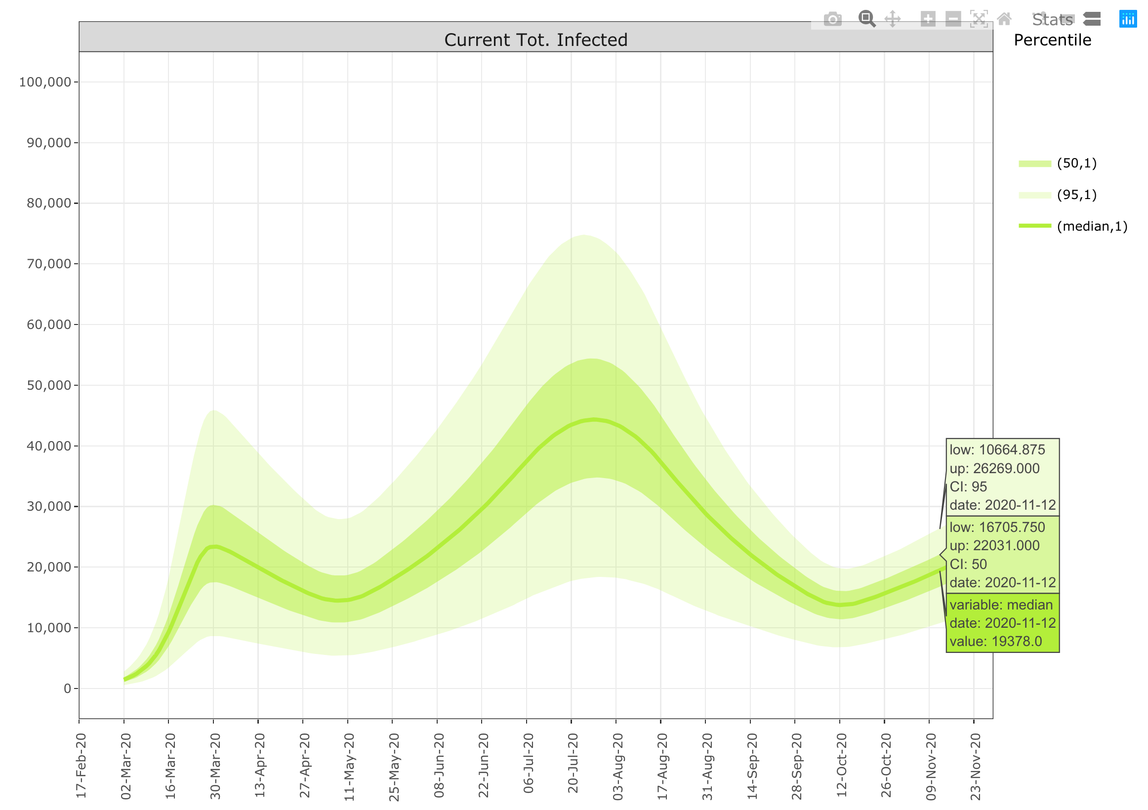
Current Observed and Estimated Total Illnesses
Median Nov 12: ~8500
→ ~0.085% of LAC population
Median Nov 12: ~20,000
→ ~0.2% of LAC population

Slide 29
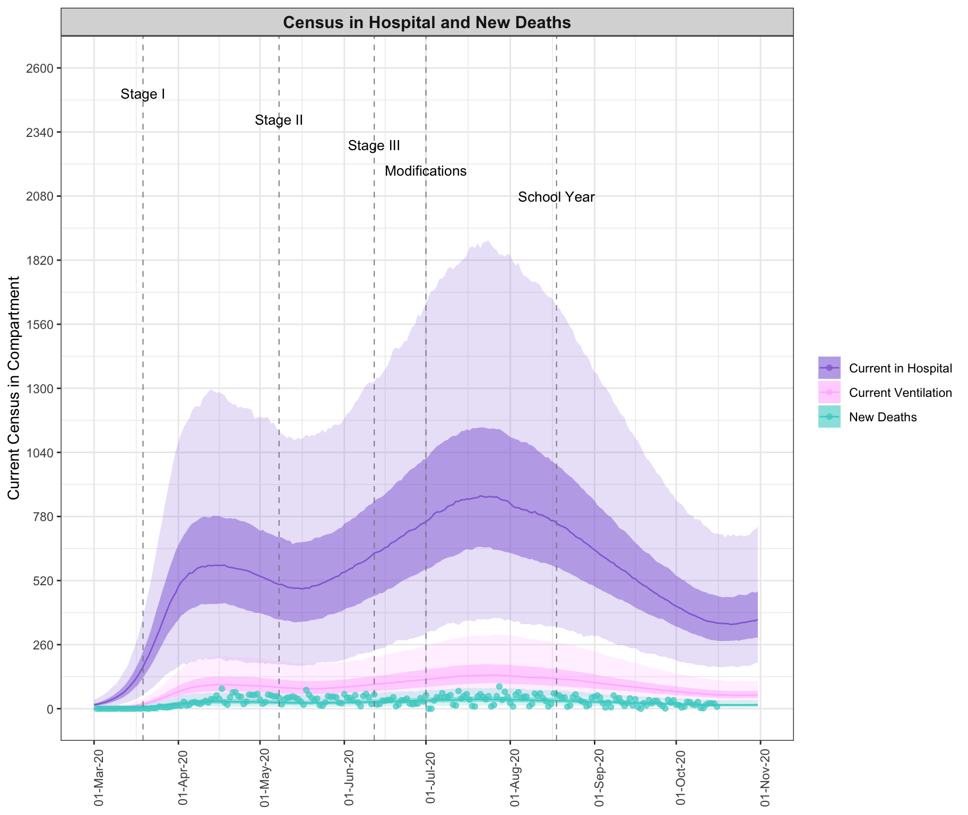
Healthcare Variables
LA County Hospital Bed
Capacity: ~4,000

Slide 30
Risk Model: Methods
Notes:
of our model over existing models estimating hospital resource demand is that it accounts for combinations of risk factors (age, unhealthy behaviors, existing comorbidities, and combinations of comorbidities), including area-level differences in prevalence of these risk factors, in determining COVID intensity. Accounting for differential risk for specific populations is important both for making projections about the scale of the epidemic, and for prioritizing at-risk populations for protection.

Slide 31
Epidemic model with stratified analysis
by risk groups
Available data:
Marginal effects of COVID outcome given single risk factors
Statistical model:
Joint effects of COVID outcome given combinations of risk factors

Slide 32
Risk Factor Data
Marginal Relative Risks:
Studies on COVID-19 with counts of hospitalization, ICU, and death based on single risk factors.
Reference correlation structure:
The National Health and Nutrition Examination Survey (NHANES 2017-2018)
Risk Factor Prevalence:
Los Angeles County Health Survey
Guan et al. 2020
Petrilli et al. 2020

Slide 33
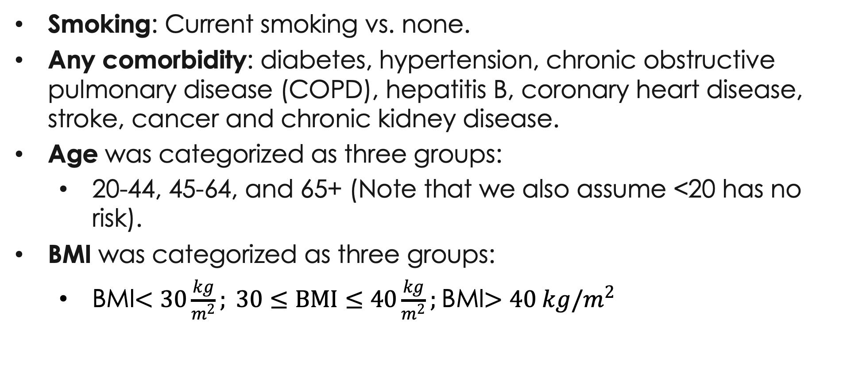
Risk Factor Data
Smoking: Current smoking vs. none.
Any comorbidity: diabetes, hypertension, chronic obstructive pulmonary disease (COPD), hepatitis B, coronary heart disease, stroke, cancer and chronic kidney disease.
Age was categorized as three groups:
20-44, 45-64, and 65+ (Note that we also assume <20 has no risk).
BMI was categorized as three groups:
BMI$<30\frac{kg}{m^{2}}; 30≤BMI≤40\frac{kg}{m^{2}};$BMI$>40 kg/m^{2}$
Guan et al. 2020 (NEJM and medrxiv version)
Petrilli et al. 2020

Slide 34
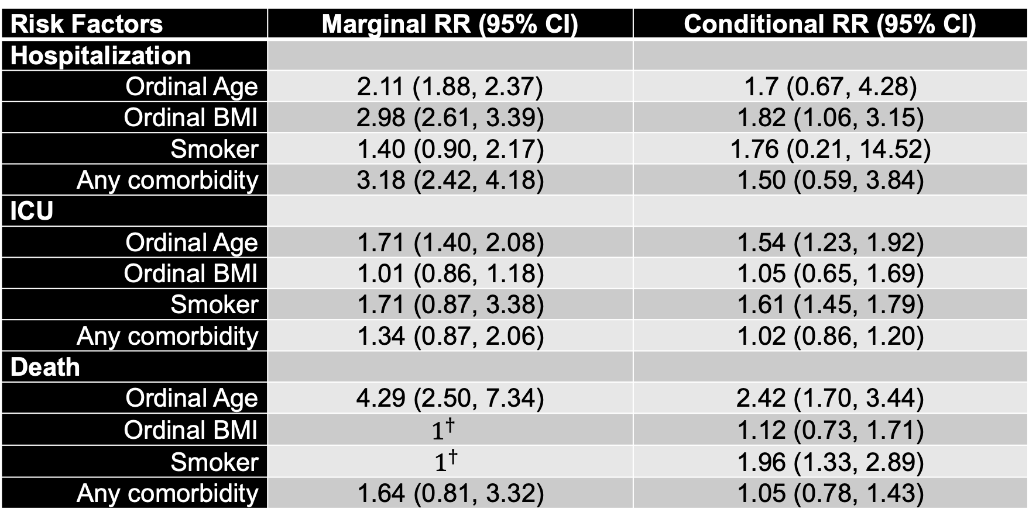
Risk Effects
Risk Factors | Marginal RR (95% CI) | Conditional RR (95% CI)
Hospitalization
Ordinal Age | 2.11 (1.88, 2.37) | 1.7 (0.67, 4.28)
Ordinal BMI | 2.98 (2.61, 3.39) | 1.82 (1.06, 3.15)
Smoker | 1.40 (0.90, 2.17) | 1.76 (0.21, 14.52)
Any comorbidity | 3.18 (2.42, 4.18) | 1.50 (0.59, 3.84)
ICU
Ordinal Age | 1.71 (1.40, 2.08) | 1.54 (1.23, 1.92)
Ordinal BMI | 1.01 (0.86, 1.18) | 1.05 (0.65, 1.69)
Smoker | 1.71 (0.87, 3.38) | 1.61 (1.45, 1.79)
Any comorbidity | 1.34 (0.87, 2.06) | 1.02 (0.86, 1.20)
Death
Ordinal Age | 4.29 (2.50, 7.34) | 2.42 (1.70, 3.44)
Ordinal BMI | $$1^{†}$$ | 1.12 (0.73, 1.71)
Smoker | $$1^{†}$$ | 1.96 (1.33, 2.89)
Any comorbidity | 1.64 (0.81, 3.32) | 1.05 (0.78, 1.43)

Slide 35
Epidemic model with stratified analysis
by risk groups
Available data:
Marginal effects of COVID outcome given single risk factors
Epidemic model:
Statistical model →
Joint effects of COVID outcome given combinations of risk factors
Risk model for post-hoc stratified analysis of risk factors
Pr(Hospital|Illness)
Pr(ICU|Hospital)
Pr(Death|ICU)

Slide 36
Epidemic model with stratified analysis
by risk groups
Available data:
Marginal effects of COVID outcome given single risk factors
Epidemic model:
Statistical model →
Joint effects of COVID outcome given combinations of risk factors
Frequency of infections by age
Pr(Hospital|Illness)
Pr(ICU|Hospital)
Pr(Death|ICU)

Slide 37
Risk Model: Results
Notes:
of our model over existing models estimating hospital resource demand is that it accounts for combinations of risk factors (age, unhealthy behaviors, existing comorbidities, and combinations of comorbidities), including area-level differences in prevalence of these risk factors, in determining COVID intensity. Accounting for differential risk for specific populations is important both for making projections about the scale of the epidemic, and for prioritizing at-risk populations for protection.

Slide 38
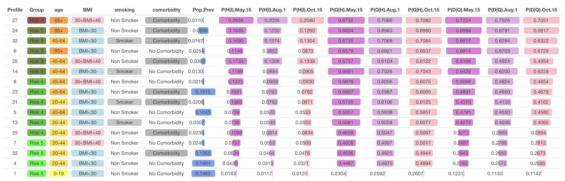
Incorporating Risk Profiles

Slide 39
Frequency of Risk Groups by Stage of Disease
RECALL:
2 Phases of the epidemic
Changing age distribution in infections:
April 20: 23% 65+, 1% <18
July 20: 12% 65+, 10% <18

Slide 40
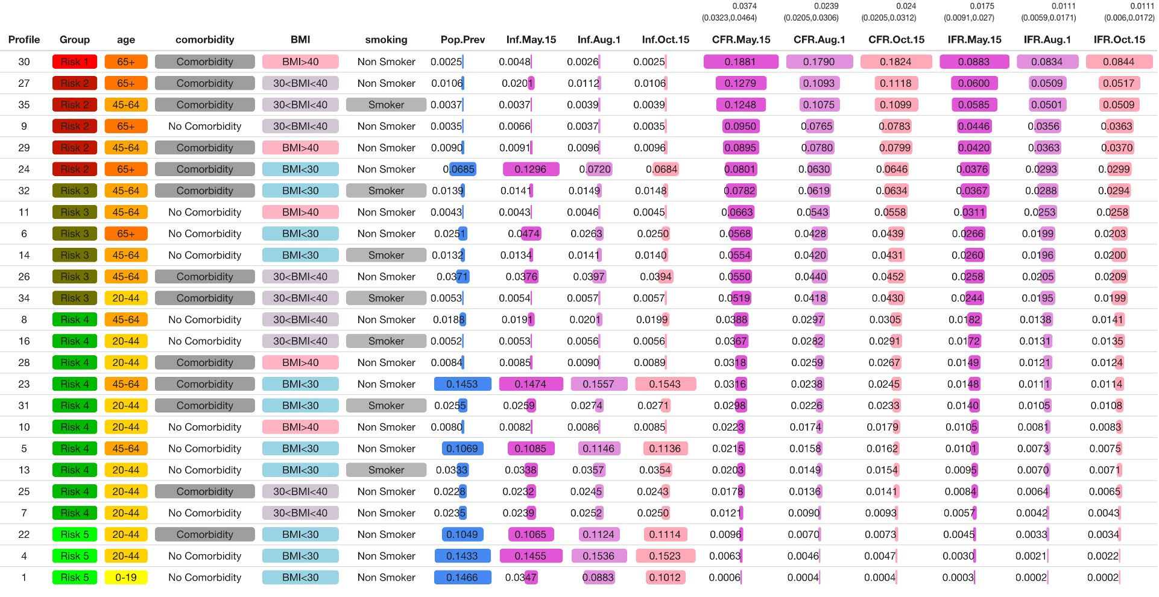
CFR and IFR by Risk Profile
3.7%
2.3%
2.4%
1.75%
1.1%
1.1%
Overall CFR/IFR decrease over time
Risk-strata specific CFR/IFR remain relatively constant
Influenza CFR=0.1%; IFR=0.05%

Slide 41
Scenario analysis: Policies implemented
Notes:
of our model over existing models estimating hospital resource demand is that it accounts for combinations of risk factors (age, unhealthy behaviors, existing comorbidities, and combinations of comorbidities), including area-level differences in prevalence of these risk factors, in determining COVID intensity. Accounting for differential risk for specific populations is important both for making projections about the scale of the epidemic, and for prioritizing at-risk populations for protection.

Slide 42
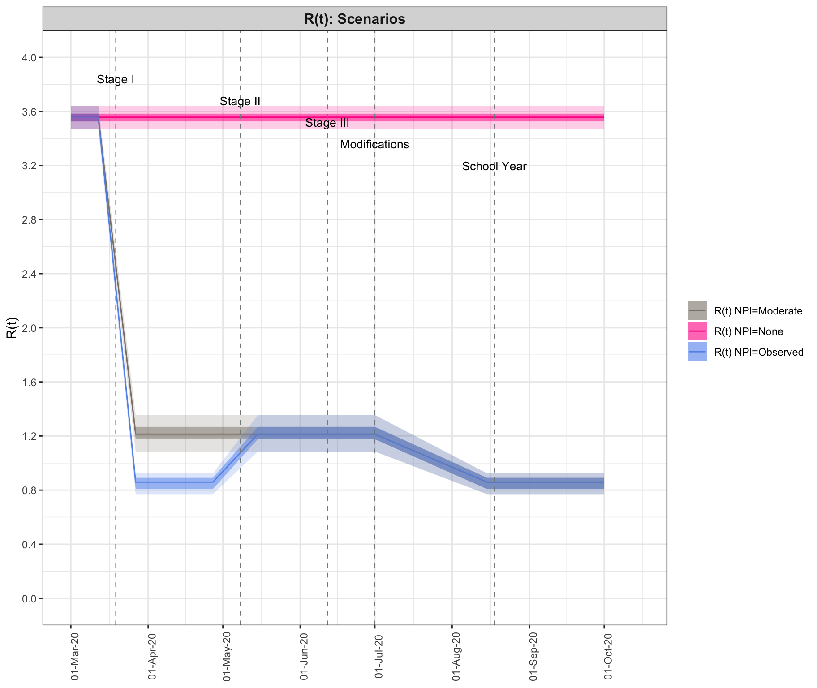
Counterfactual: Differing Social Distancing

Slide 43
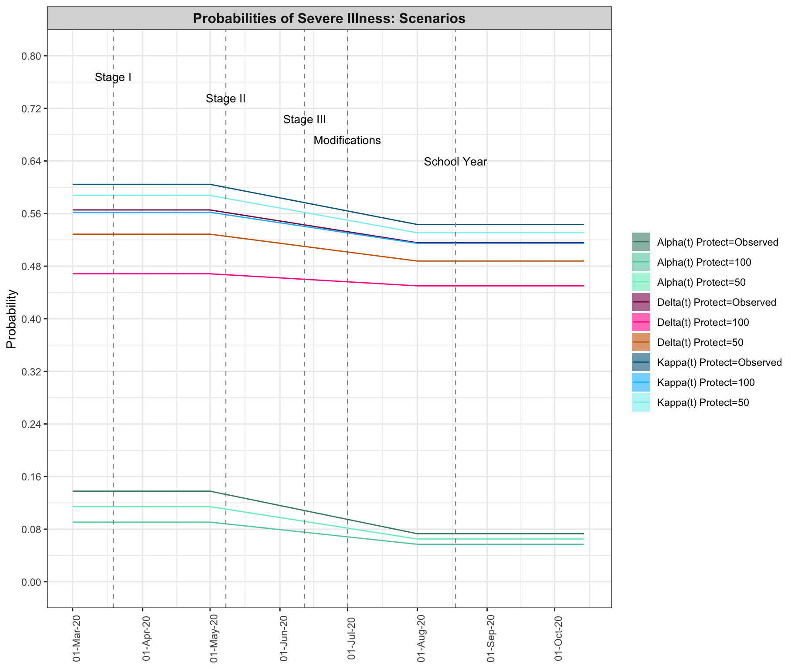
Counterfactual: Protect the At-Risk (e.g. 65+)

Slide 44
Scenario analysis: Results
Notes:
of our model over existing models estimating hospital resource demand is that it accounts for combinations of risk factors (age, unhealthy behaviors, existing comorbidities, and combinations of comorbidities), including area-level differences in prevalence of these risk factors, in determining COVID intensity. Accounting for differential risk for specific populations is important both for making projections about the scale of the epidemic, and for prioritizing at-risk populations for protection.

Slide 45
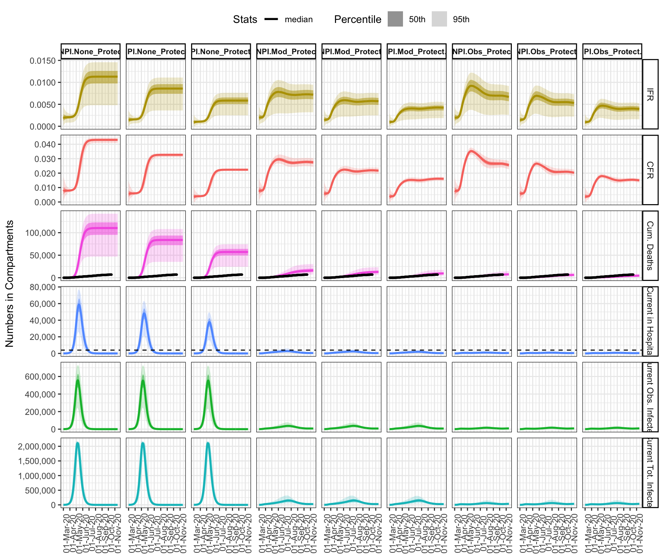
Scenario Results
Notes:
The strict initial lockdown period in LAC was effective because it both reduced overall transmission and protected individuals at greater risk, resulting in preventing both healthcare overload and deaths (especially among individuals 65+). Simulation re- sults suggest that an initial implementation of a moderate NPI policy on its own would not have been sufficient to avoid overwhelming healthcare capac- ity, and additionally would have exceeded the observed death count by over 450 100%. Combining the moderate NPI policy with a stringent protection of all individuals 65+ would have resulted in a death count at a similar level as ob- served, however hospital capacity limits would have approached exceeding levels likely resulting in more severe illnesses and deaths than accounted for by this model. A more moderate protection scenario in which 50% of individuals 65+ 455 are isolated would have resulted in slightly surpassing the observed death toll and similarly threatening to exceed healthcare capacity. Thus, while similar numbers of deaths as observed in LAC could have been achieved while avoiding initial lockdown through the implementation of a more moderate NPI policy combined with greater protection of individuals 65+, this would have come at 460 the expense of overwhelming the healthcare system.

Slide 46
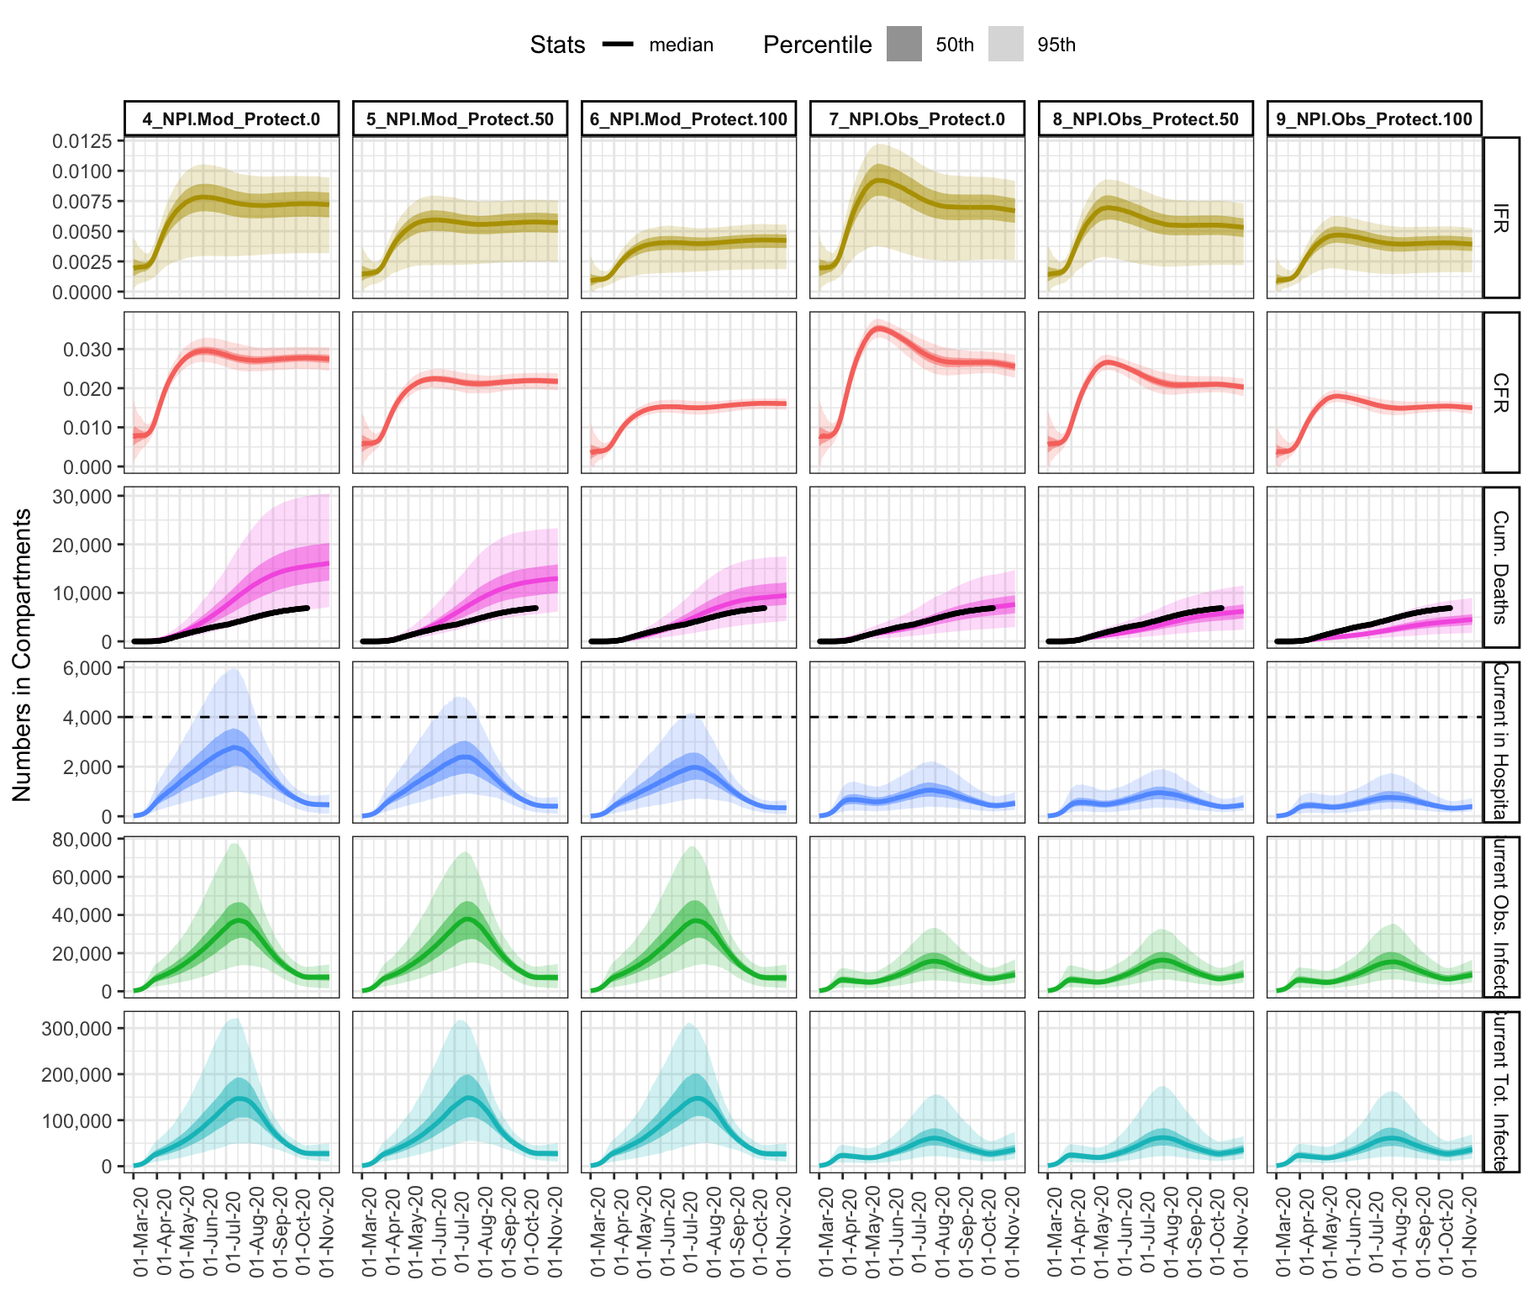
Scenario Results
The strict initial lockdown period in LAC was effective because it both reduced overall transmission and protected individuals at greater risk
Moderate NPIs/shutdown + protection of individuals of greater risk would have overwhelmed healthcare capacity and doubled the death count
Notes:
The strict initial lockdown period in LAC was effective because it both reduced overall transmission and protected individuals at greater risk, resulting in preventing both healthcare overload and deaths (especially among individuals 65+). Simulation re- sults suggest that an initial implementation of a moderate NPI policy on its own would not have been sufficient to avoid overwhelming healthcare capac- ity, and additionally would have exceeded the observed death count by over 450 100%. Combining the moderate NPI policy with a stringent protection of all individuals 65+ would have resulted in a death count at a similar level as ob- served, however hospital capacity limits would have approached exceeding levels likely resulting in more severe illnesses and deaths than accounted for by this model. A more moderate protection scenario in which 50% of individuals 65+ 455 are isolated would have resulted in slightly surpassing the observed death toll and similarly threatening to exceed healthcare capacity. Thus, while similar numbers of deaths as observed in LAC could have been achieved while avoiding initial lockdown through the implementation of a more moderate NPI policy combined with greater protection of individuals 65+, this would have come at 460 the expense of overwhelming the healthcare system.

Slide 47
Next Steps
Epidemic Predictions
Multi-population model:
Race/ethnicity
Age groups
Spatial resolution (meta-populations)
Include a vaccination component
Refining the Risk Model
Inclusion of additional risk factors
Use of individual-level data –when available

Slide 48
Websites
https://uscbiostats.github.io/COVID19/
https://abigailhorn.github.io/COV2-LA/

Slide 49
The Team
USC Department of Preventive Medicine
Lai Jiang, MS Biostatistics PhD Candidate
Emil Hvitfeldt, MS Research Programmer
Wendy Cozen, DO, MPH Professor of Preventive Medicine
Kayla de la Haye Assistant Professor of Preventive Medicine
USC School of Public Policy
Neeraj Sood, Professor and Vice Dean of Research
Los Angeles County Department of Public Health (LACDPH)
Paul Simon, MD, MPH, Chief Science Officer
Will Nicholas, PhD, MPH Director, Center for Health Impact Evaluation, LACDPH
Faith Washburn, MPH Epidemiology Analyst

Slide 50


